Slide 1
Big Data ‘22 - Lecture 15
REST

Slide 2
There will be a quiz Wednesday
Modern Data Stack => REST will be included

Slide 3
You have two systems - how do they communicate?
Web Server
Web client
Micro
Service #1
Micro
Service #2
Android client
Twitter API

Slide 4
Well...
At first, this might seem like an easy problem. You may have solved it before. But..
What “language” do they speak to each other?
What should each system know about the other system?
How do we define what each system does?
What is the unit of communication?
How often should I check back to get new information?
What happens when we have more than one client to our service?
Do we have to define this every time we build something new?

Slide 5
Enter REST (in 2000)
REST Stands for Representational State Transfer, which is an architectural style for web services. A service based on REST is called a RESTful service.
REST is not: An application, framework, library, or the same as HTTP
REST is primarily used to build Web services that are lightweight, maintainable, and scalable.
Why should you care? Every major development language now includes frameworks for building RESTful Web services. It is imperative for developers to have a clear understanding of REST and RESTful services.
Examples: Express (JS), Sinatra (Ruby), Flask (Python), Finatra (Scala), Spring (Java), …

Slide 6
What makes a RESTful service?
A set of constraints that predictably help service achieve benefits such as performance, scalability, simplicity, modifiability, visibility, portability, and reliability.
Client–server architecture
Statelessness
Cacheability
Layered system
Uniform interface
We’ll talk about each in more detail.

Slide 7
Client-Server Architecture
The Client application and the Server application must be able to evolve independently.
The Client doesn’t need to know about the internals of the server.
Definitions
Client: the service making the request. This might be a web or mobile client, or may be another server application.
Server: The service fulfilling the request and responsible for the resources. This might be a server you own, or this might be the Twitter API.

Slide 8
Statelessness
The server cannot maintain the application state for any client
A request cannot be dependent on a past request and a service treats each request independently
An example of a stateful service:
Request 1: Return the first user
Request 2: Return the second user
Why?
Stateless services are easier to maintain and scale, since the server doesn’t have to keep track of N client’s application state.

Slide 9
Cacheability
Each response should include whether the response is cacheable or not and for how long the response should be cached by the client
Why?
This allows us to entirely eliminate some portion of the client-server interactions, further improving performance.

Slide 10
Layered System
If the server authenticates requests, stores data, and hosts APIs on different services, the client should be agnostic of those underlying concerns.
Why?
Furthers our ability to separate concerns in our server
Allows us to introduce proxies, caches, load balancers, and other focused systems without interrupting the client-server relationship.

Slide 11
Uniform Interface (this is a big one)
A server should have a uniform way of interacting with all of its clients.
Resources: The unit of data requested
Akin to an object in OOP
Example: A Twitter User.
Representations: A grouping of information about the resource that the server exposes.
Usually (and intentionally) not the same as the database representation
Could be XML, JSON, or something else. REST is not prescriptive, but JSON is most common.
Why?
Consistency, discoverability, predictability, ...

Slide 12
Resources and Representations
For example a resource called "Person" can be represented as:
1 2 3 4 5 6 | { "ID": "1", "Name": "G Greenstreet", "Email": "Gregory.Greenstreet@gmail.com", "Country": "United States" }

Slide 13
How this looks in practice
Again: REST is an architectural style, it isn’t a library to import or specific implementation.
RESTful services are most often implemented in HTTP
Many many libraries to help you with building HTTP RESTful services
We’ll spend some time looking at what this looks like

Slide 14
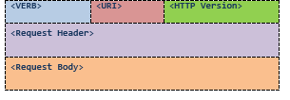
HTTP Request
The client and server talk to each other via messages. Clients send a request to the server, and the server replies with a response. Apart from the actual data, these messages also contain some metadata about the message. It is important to have some background about the HTTP 1.1 request and response formats for designing RESTful Web services.
HTTP Request

Slide 15
HTTP Request cont...
<VERB> is one of the HTTP methods like GET, PUT, POST, DELETE, OPTIONS, etc
<URI> is the Uniform Resource Identifier (URI) of the resource on which the operation is going to be performed. We’ll talk more about this in a bit.
<HTTP Version> is the version of HTTP, generally "HTTP v2" .
<Request Header> contains the metadata as a collection of key-value pairs of headers and their values. These settings contain information about the message and its sender like client type, the formats client supports, format type of the message body, cache settings for the response, and a lot more information.
<Request Body> is the actual message content. In a RESTful service, that's where the representations of resources sit in a message.

Slide 16
HTTP Get
This is the GET request that was created by my browser when I tried to visit the HTTP 1.1 specifications on w3.org:
GET http://www.w3.org/Protocols/rfc2616/rfc2616.html HTTP/1.1
Host: www.w3.org
Accept: text/html,application/xhtml+xml,application/xml; …
User-Agent: Mozilla/5.0 (Windows NT 6.3; WOW64) AppleWebKit/537.36 …
Accept-Encoding: gzip,deflate,sdch
Accept-Language: en-US,en;q=0.8,hi;q=0.6
There is no message body in this request. The Accept header tells the server about the various presentation formats this client supports. A server, if it supports more than one representation format, it can decide the representation format for a response at runtime depending on the value of the Accept header. User-Agent contains information about the type of client who made this request. Accept-Encoding/Language tells about the encoding and language this client supports.

Slide 17
HTTP Post
A POST request message, which is supposed to insert a new resource Person.
POST http://MyService/Person/
Host: MyService
Content-Type: application/json; charset=utf-8
Content-Length: 123
{
“Id”: “1”,
“Name”: “Newsom”,
“Email”: “brian.newsom@colorado.edu”,
“Country”: “United states”
}

Slide 18
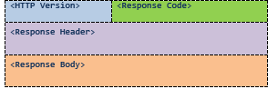
HTTP Response
HTTP response format.
The server returns <response code>, which contains the status of the request. This response code is generally the 3-digit HTTP status code.
<Response Header> contains the metadata and settings about the response message.
<Response Body> contains the representation if the request was successful.

Slide 19
HTTP Response
An actual response to a GET request..
HTTP/1.1 200 OK
Date: Sat, 23 Aug 2014 18:31:04 GMT
Server: Apache/2
Last-Modified: Wed, 01 Sep 2004 13:24:52 GMT
Accept-Ranges: bytes
Content-Length: 32859
Cache-Control: max-age=21600, must-revalidate
Expires: Sun, 24 Aug 2014 00:31:04 GMT
Content-Type: text/html; charset=iso-8859-1
<!DOCTYPE html PUBLIC "-//W3C//DTD XHTML 1.0 Strict//EN" "http://www.w3.org/TR/xhtml1/DTD/xhtml1-strict.dtd">
<html xmlns='http://www.w3.org/1999/xhtml'>
<head><title>Hypertext Transfer Protocol -- HTTP/1.1</title></head>
<body>
...

Slide 20
HTTP Response
An actual response to a GET request..
HTTP/1.1 200 OK
Date: Sat, 23 Aug 2014 18:31:04 GMT
Server: Apache/2
Last-Modified: Wed, 01 Sep 2004 13:24:52 GMT
Accept-Ranges: bytes
Content-Length: 32859
Cache-Control: max-age=21600, must-revalidate
Expires: Sun, 24 Aug 2014 00:31:04 GMT
Content-Type: text/html; charset=iso-8859-1
<!DOCTYPE html PUBLIC "-//W3C//DTD XHTML 1.0 Strict//EN" "http://www.w3.org/TR/xhtml1/DTD/xhtml1-strict.dtd">
<html xmlns='http://www.w3.org/1999/xhtml'>
<head><title>Hypertext Transfer Protocol -- HTTP/1.1</title></head>
<body>
...
The response code 200 OK means that everything went well and the response message body contains a valid representation of the resource I requested. In this case, the representation is an HTML document that is declared by Content-Type header in the response header.

Slide 21
Addressing Resources
REST requires each resource to have at least one URI. A RESTful service uses a directory hierarchy like human readable URIs to address its resources.
The job of a URI is to identify a resource or a collection of resources. The actual operation is determined by an HTTP verb. The URI should not say anything about the operation or action. This enables us to call the same URI with different HTTP verbs to perform different operations.
Suppose we have a database of persons and we wish to expose it to the outer world through a service. A resource person can be addressed like this:
http://MyService/Persons/1

Slide 22
Addressing Resources
This URL has following format: Protocol://ServiceName/ResourceType/ResourceID
Here are some important recommendations for well-structured URIs:
Use plural nouns for naming your resources.
Avoid using spaces. Use an _ (underscore) or – (hyphen) instead.
A URI is case insensitive. camelCase or kebab-case are usually good options.
Versioning will make your life easier
Can be done in the URI, or in HTTP headers
Consistency is key.
It becomes easier for your clients to construct the URIs programmatically if they are aware of the resource hierarchy and the URI convention you follow.
Be thoughtful about your initial URI design and any changes you make.
Removing an old URI will break the interface for clients. If you need to change the location of a resource, do not discard the old URI. If a request comes for the old URI, use status code 300 and redirect the client to the new location.
Avoid verbs for your resource names until your resource is actually an operation or a process. Verbs are more suitable for the names of operations. For example, a RESTful service should not have the URIs http://MyService/FetchPerson/1 or http://MyService/DeletePerson?id=1.

Slide 23
Query Parameters
The preceding URI is constructed with the help of a query parameter: http://MyService/Persons?id=1
The query parameter approach works just fine and REST does not stop you from using query parameters. However, this approach has a few disadvantages.
Increased complexity and reduced readability, which will increase if you have more parameters
Search-engine crawlers and indexers like Google ignore URIs with query parameters. If you are developing for the Web, this would be a great disadvantage as a portion of your Web service will be hidden from the search engines.
The basic purpose of query parameters is to provide parameters to an operation that needs the data items. For example, if you want the format of the presentation to be decided by the client. You can achieve that through a parameter like this:
http://MyService/Persons/1?format=compact
Including the parameters format and encoding here in the main URI in a parent-child hierarchy will not be logically correct as they have no such relation:
http://MyService/Persons/1/json/UTF8
Query parameters also allow optional parameters. This is not otherwise possible in a URI. You should use query parameters only for the use they are intended for: providing parameter values to a process.

Slide 24
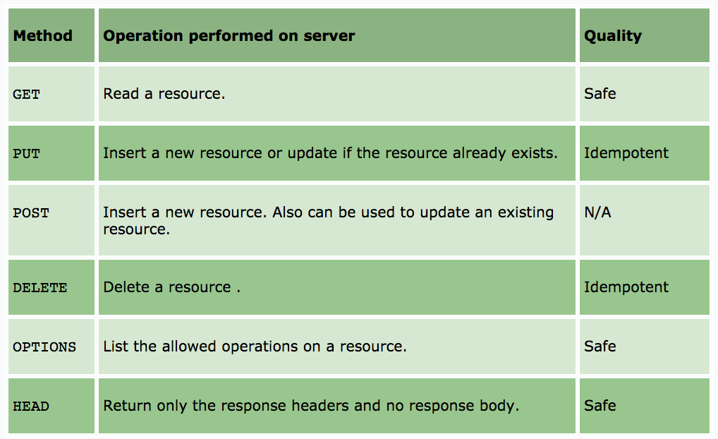
Uniform Interfaces in HTTP
Reminder: RESTful systems should have a uniform interface. HTTP 1.1 provides a set of methods, called verbs, for this purpose. Among these the more important verbs are:

Slide 25
Difference between Put and Post

Slide 26
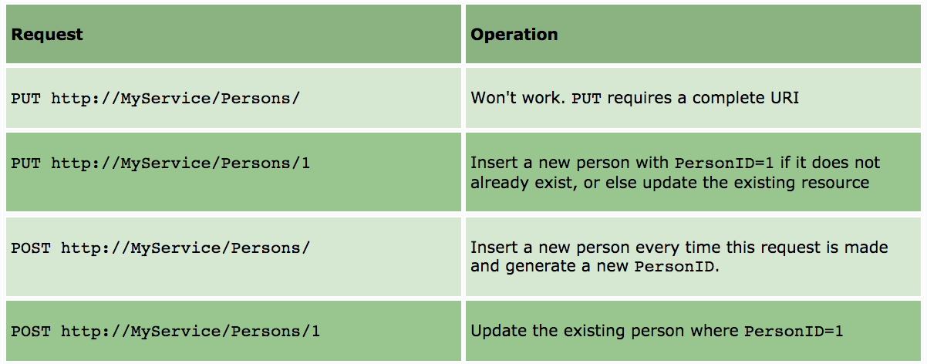
Difference between Put and Post
Most commonly a POST is used for creation and a PUT is used for an update
Formally: The key difference between PUT and POST is that PUT is idempotent while POST is not.
No matter how many times you send a PUT request, the results will be same.
Another difference is that, with PUT, you must always specify the complete URI of the resource. This implies that the client should be able to construct the URI of a resource even if it does not yet exist on the server.
This is possible when it is the client's job to choose a unique name or ID for the resource, just like creating a user on the server requires the client to choose a user ID. If a client is not able to guess the complete URI of the resource, then you have no option but to use POST.

Slide 27
Documenting a Restful Service
RESTful services do not necessarily require a document to help clients discover them.
Due to URIs, links, and a uniform interface, it is usually simple to discover RESTful services at runtime. A client can simply know the base address of the service and from there it can discover the service on its own by traversing through the resources using links. The method OPTION can be used effectively in the process of discovering a service.
This does not mean that RESTful services require no documentation at all. There is no excuse for not documenting your service. You should document every resource and URI for client developers. You can use any format for structuring your document, but it should contain enough information about resources, URIs, Available Methods, and any other information required for accessing your service.

Slide 28
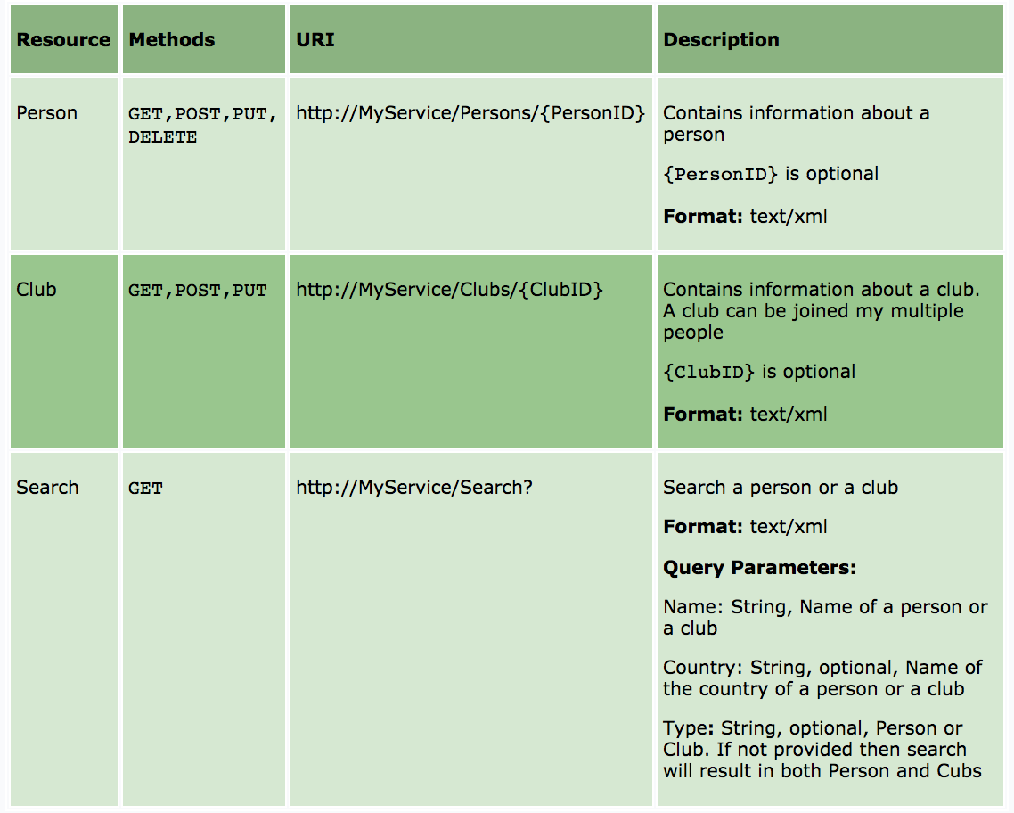
Documenting a Restful Service
The Table below is a sample documentation of MyService. This is a simple and short document that contains all the aspects of MyService and should be sufficient for developing a client.
Service Name: MyService
Address: http://MyService/

Slide 29

Are there other options?

Slide 30
Alternatives: GraphQL
You often don’t need all the data in the server’s representation
What if we could ask only for the data we care about?
What if we could retrieve multiple resources in a single HTTP request?

Slide 31
Alternatives: GraphQL
Advantages
Send and receive less unused data over the network
Simplify client transformations of data
Get many resources in a single request
Evolve API with less hassle / versioning
Disadvantages
Pushes complexity to the server
Queries can be unexpectedly expensive
Error handling can be more difficult

Slide 32
GraphQL example
Client
Query GET /graphql?query=”
{
me {
name
}
}”
Server
type User {
id: ID
name: String
address: Address
}
Response
{
"me": {
"name": "Luke Skywalker"
}
}

Slide 33
Recap
REST is an extremely common software architecture pattern that you will use
REST defines a set of constraints that make systems easier to build and scale
You will probably build a RESTful web server for your Project, and you will almost certainly interact with one as a client
REST is usually implemented in HTTP and includes operating on a set of resources with HTTP Verbs: GET, PUT, POST, and DELETE
We’ll talk more about API design later on this semester
GraphQL is a growing alternative to REST, but REST isn’t going anywhere soon
Questions?

